Slide 1

The Rolling Scopes #30

Slide 2
WiFi
EPAMGuests or EPAMGuests5
Login: EPAM_Guest1
Pass: 9rvs

Slide 3
"The Rolling Scopes" - a non-profit JavaScript/Front-end community

Slide 4
Hashtag
#RollingScopes

Slide 5
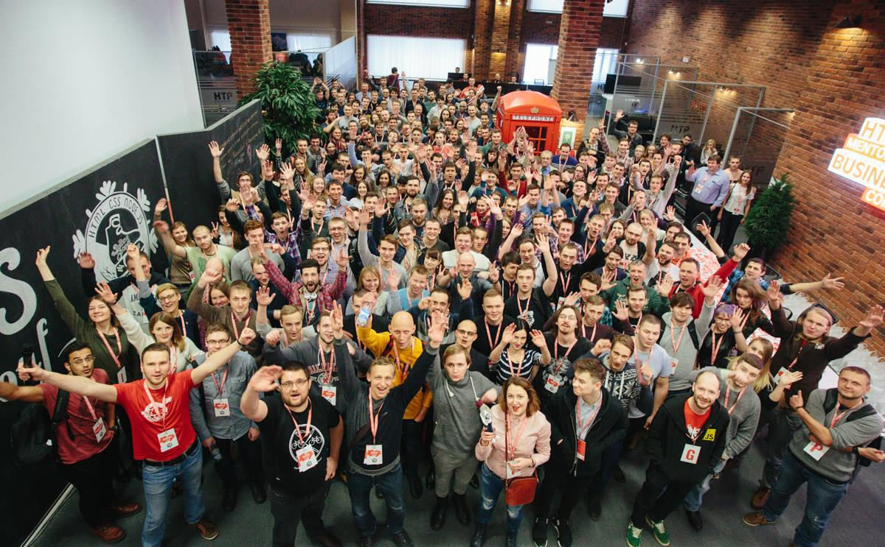
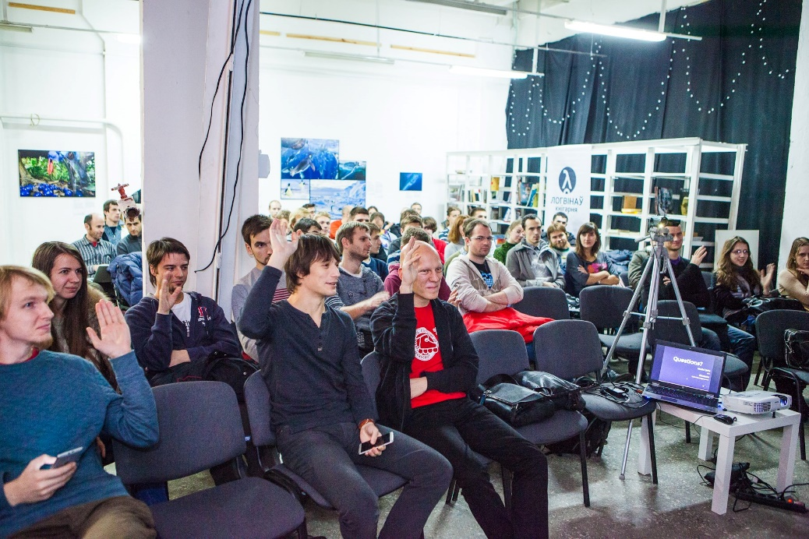
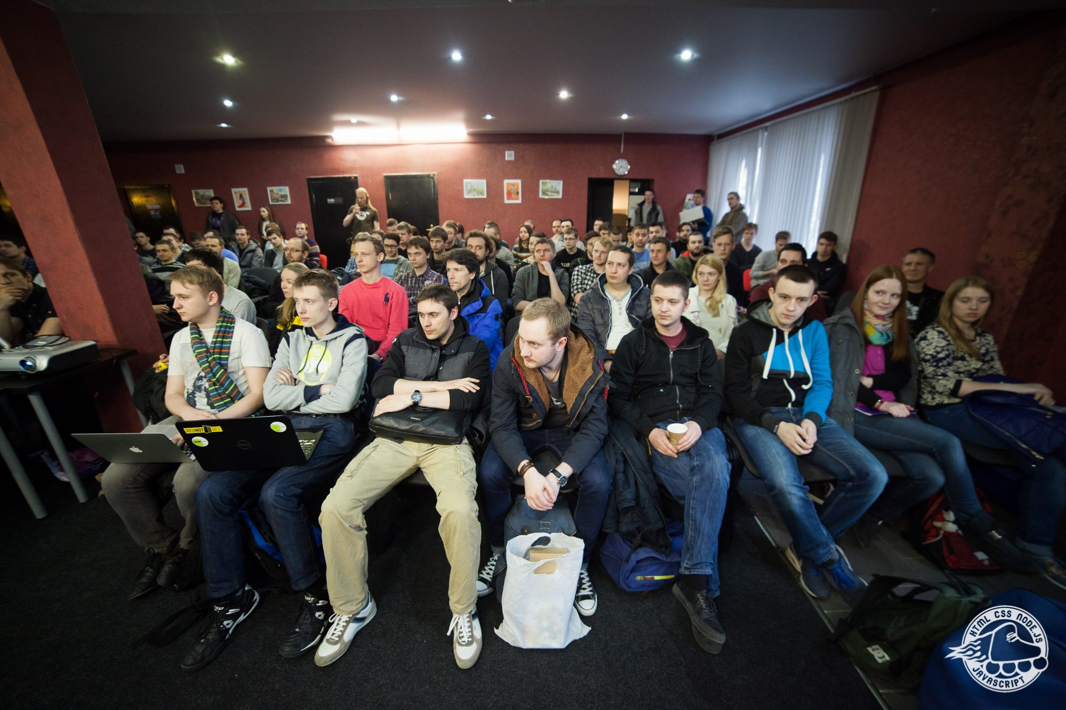
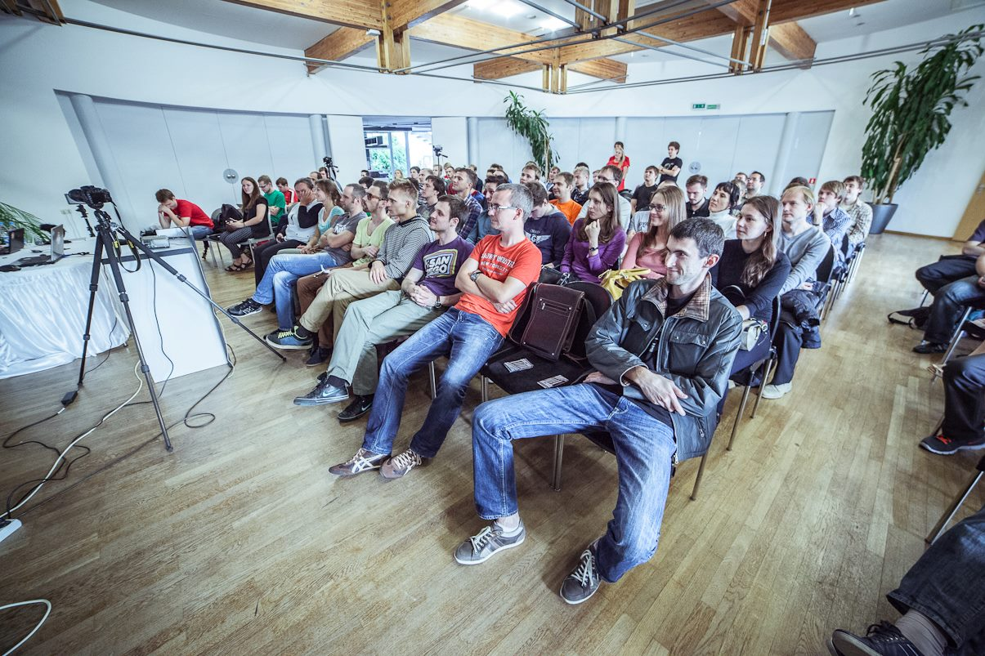
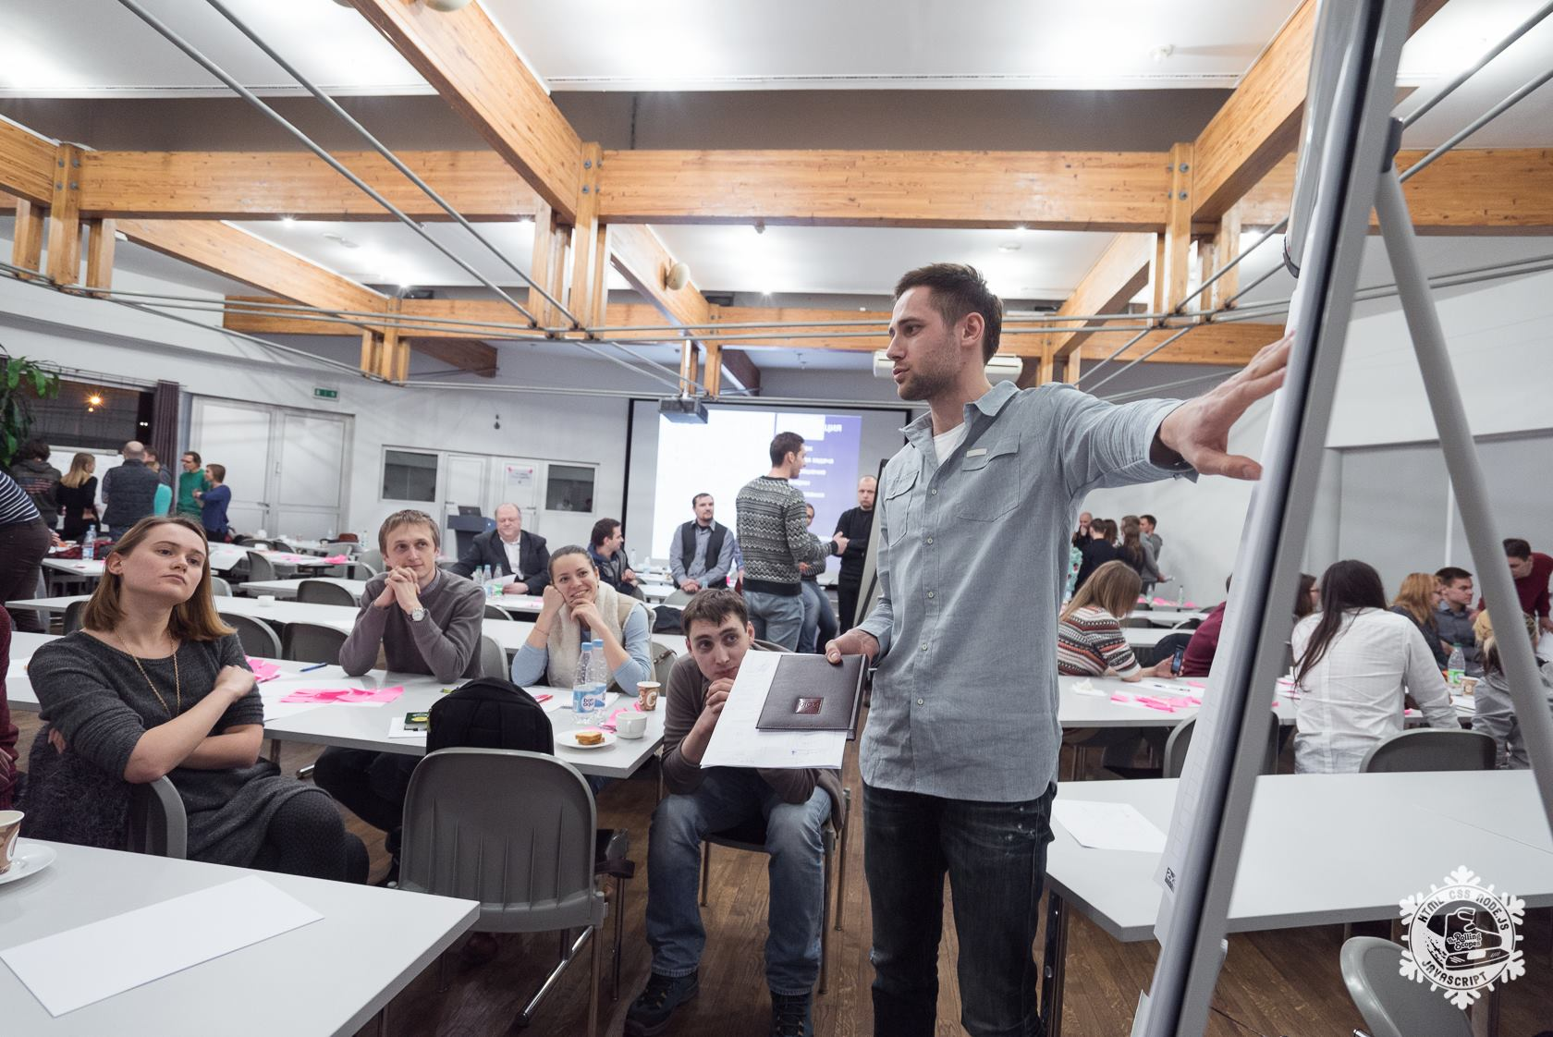
35+ Events 70+ Speakers 130+ Talks 750+ members

Slide 6
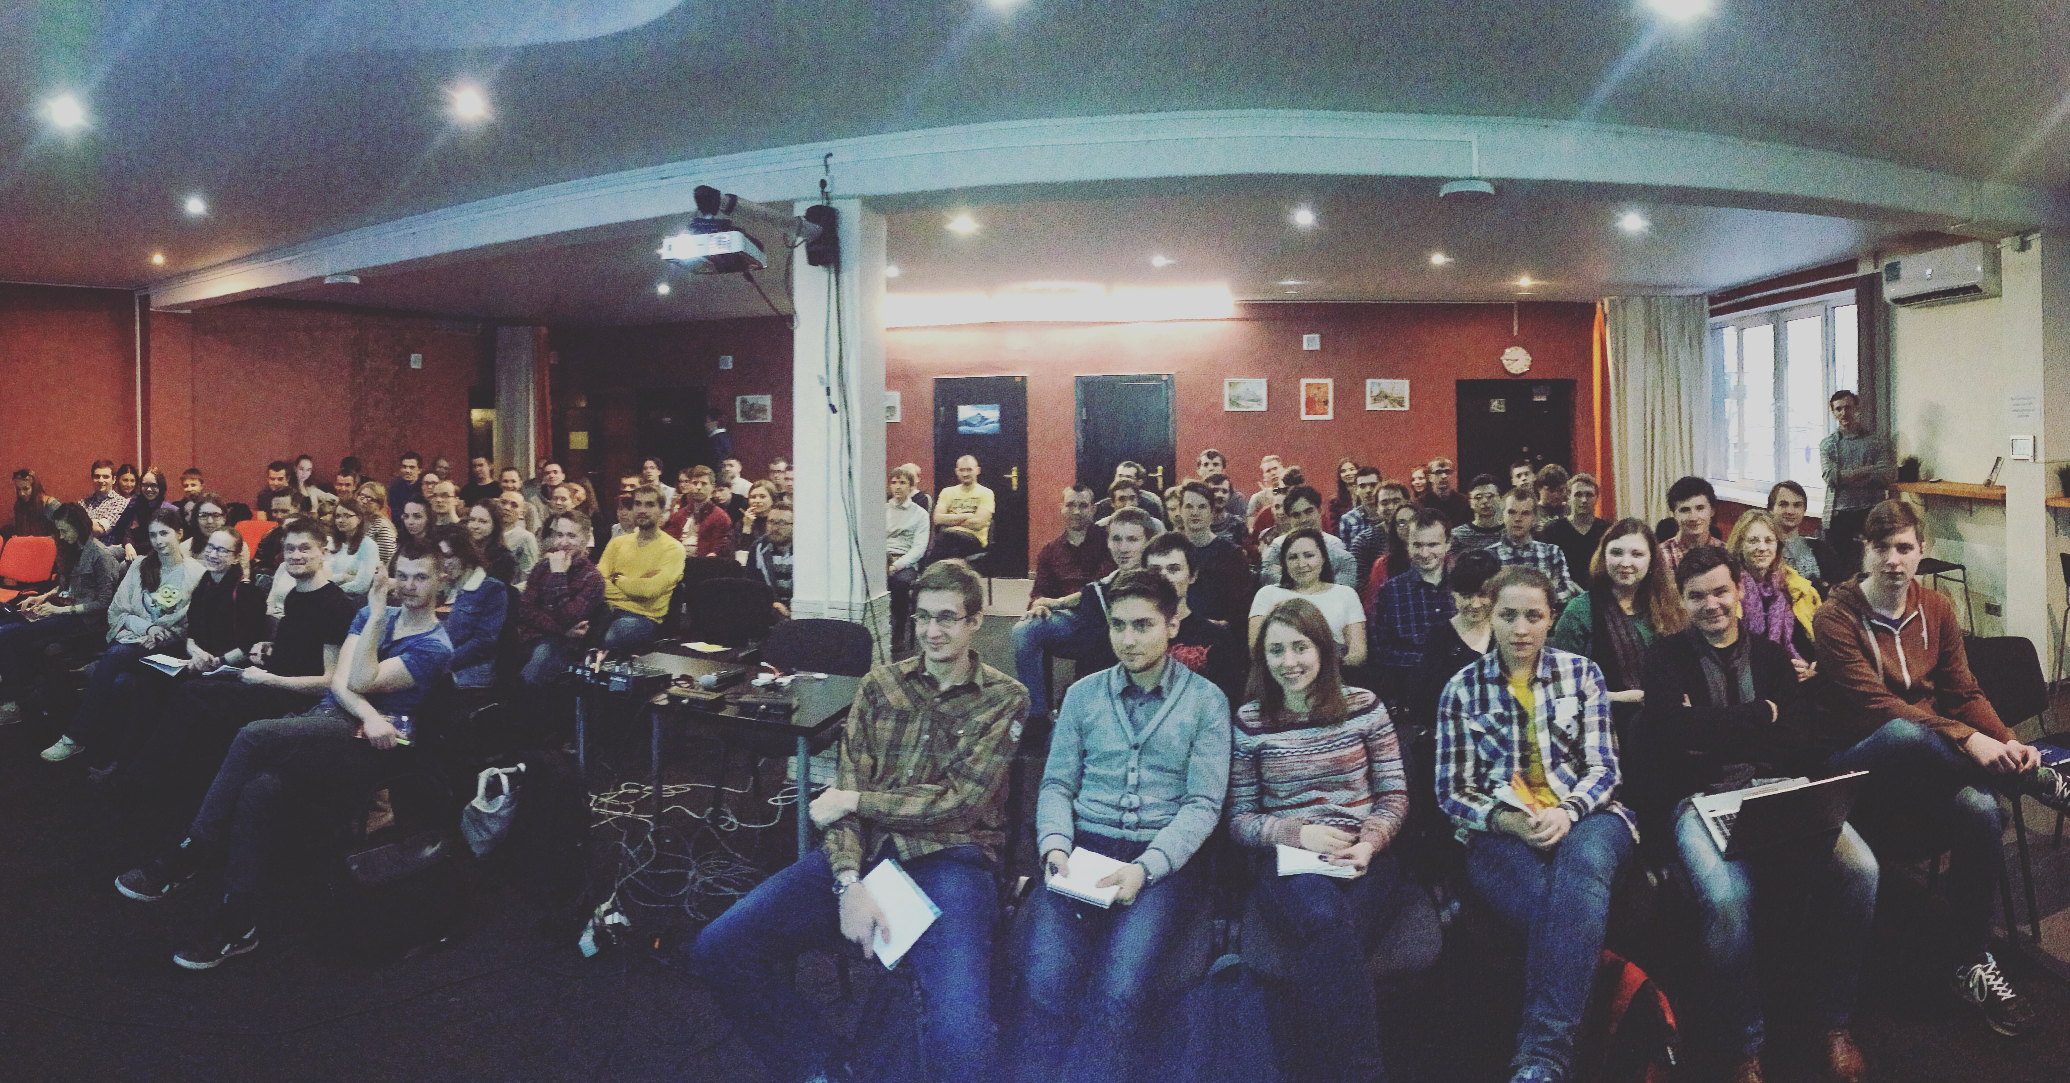

The Rolling Scopes School
120+ hours
~100 attendies
6 cycles already passed

Slide 7
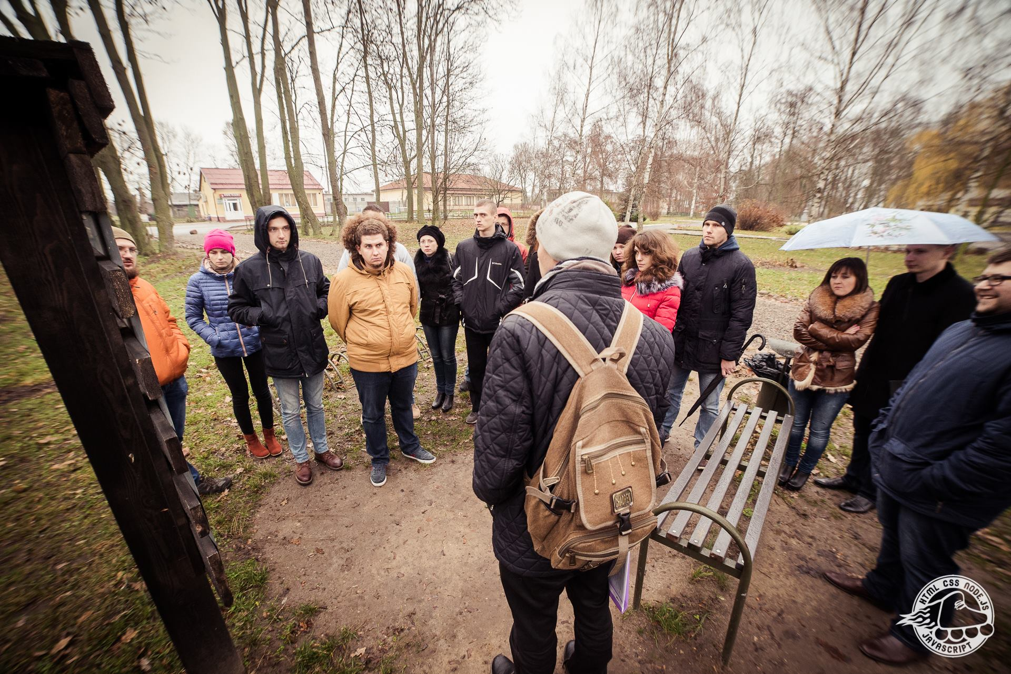

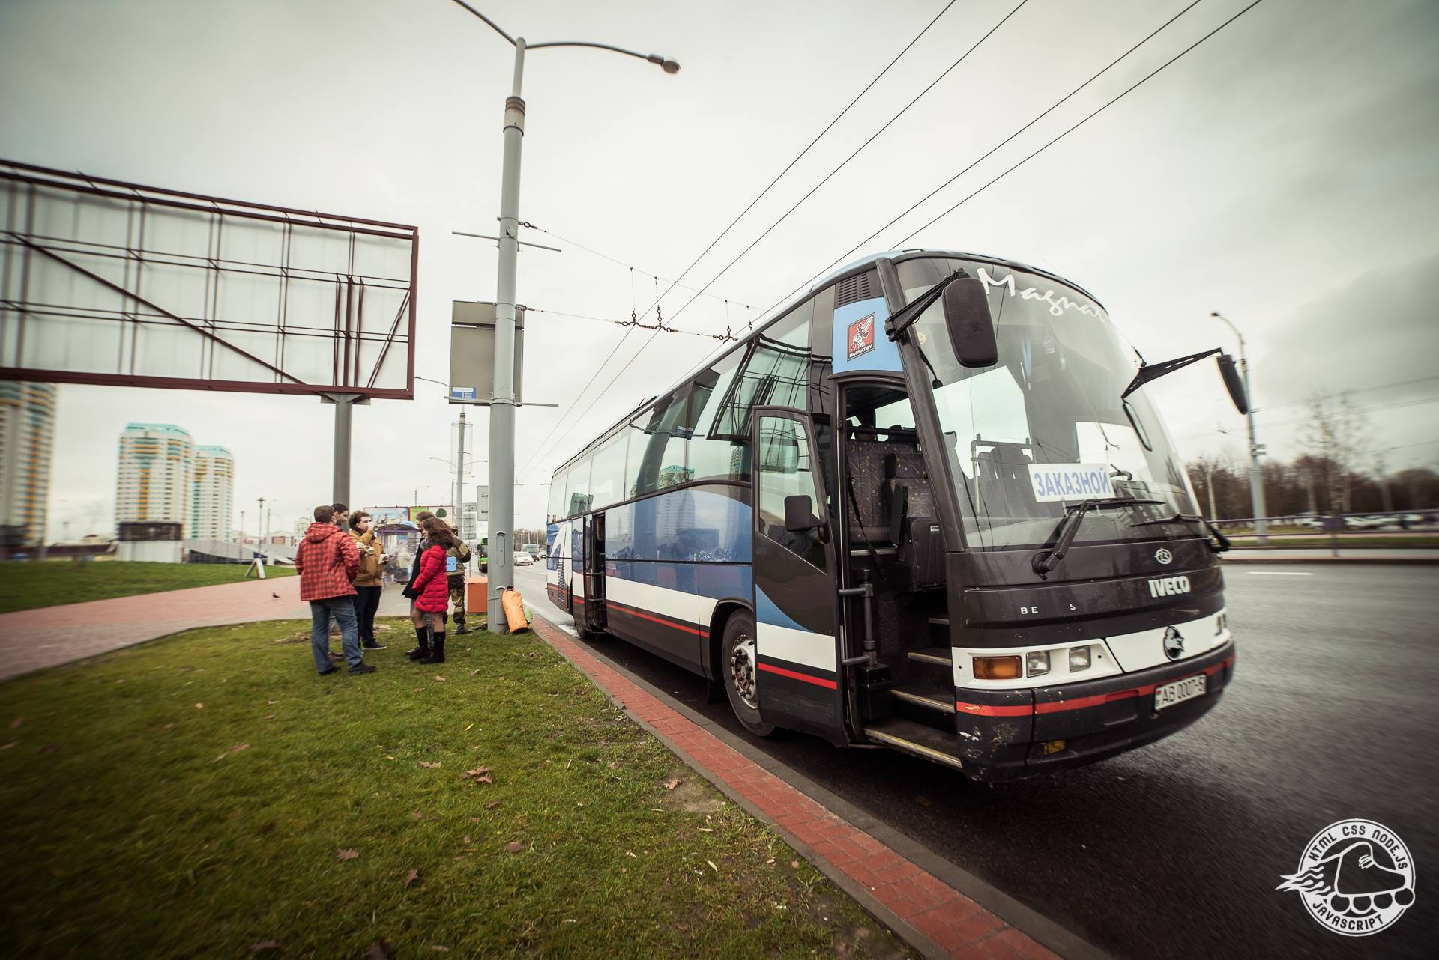
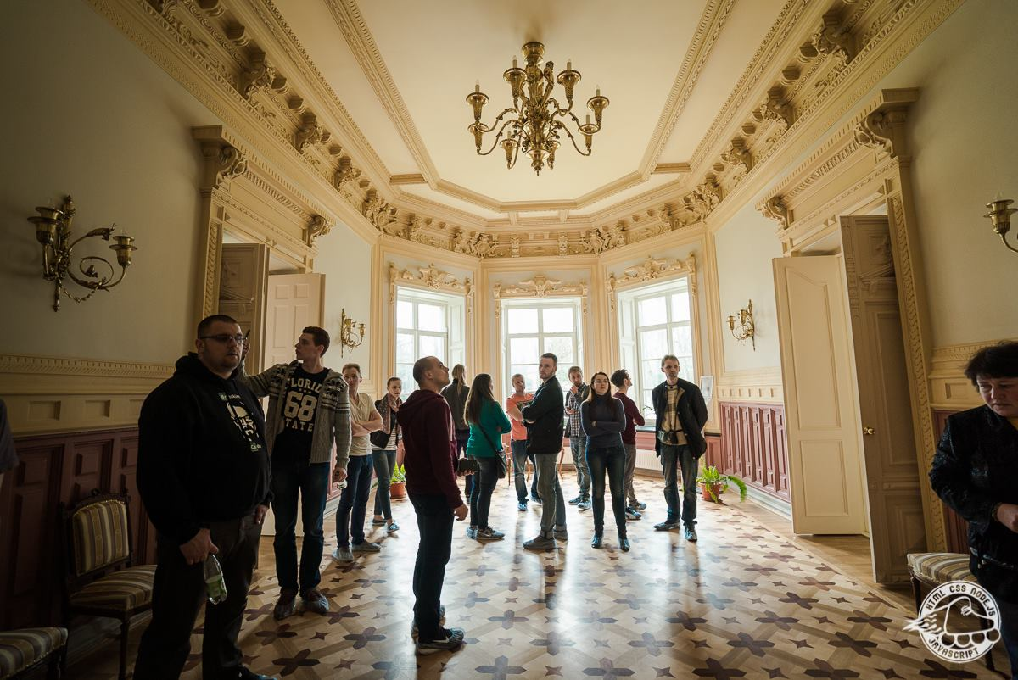
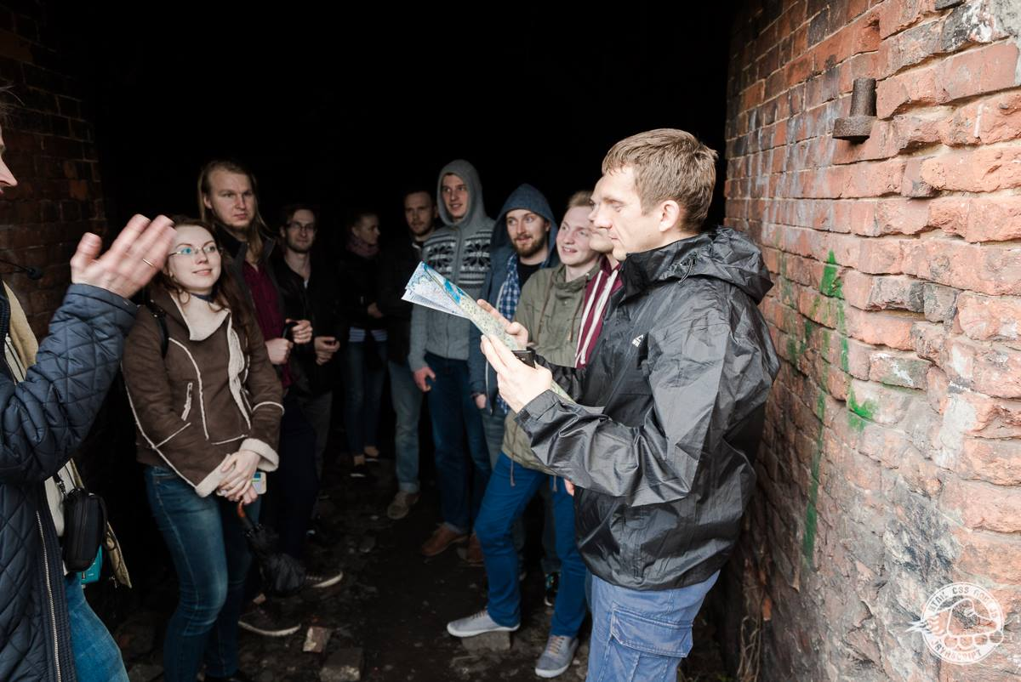
Different locations:
Minsk, Brest, Gomel, Krakow, Your city?

Slide 8
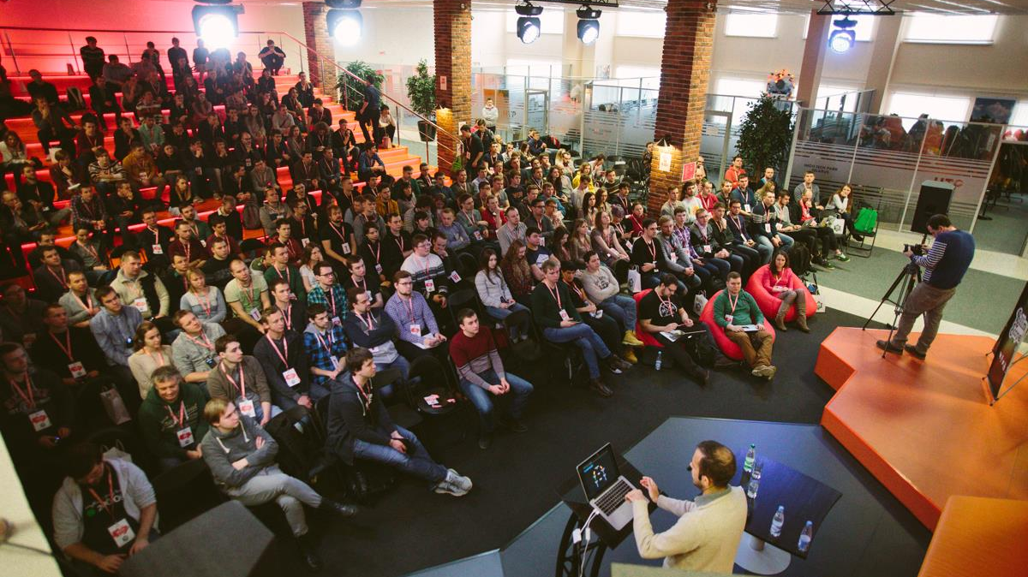

THE ROLLING SCOPES CONFERENCE

Slide 9
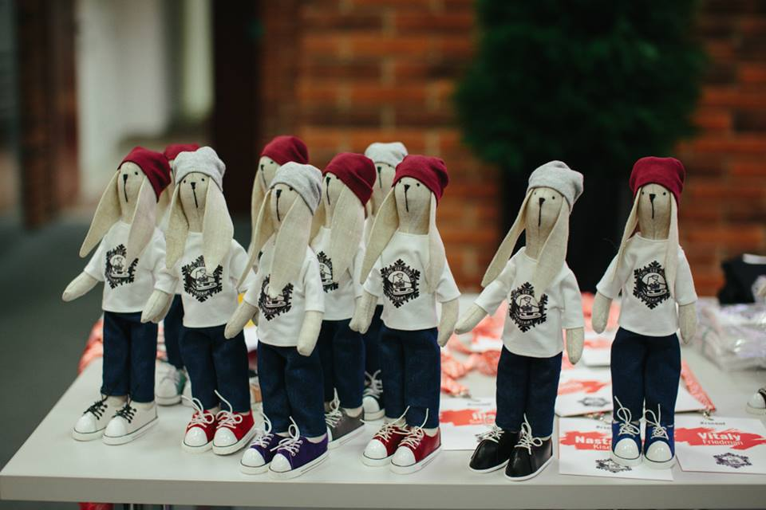
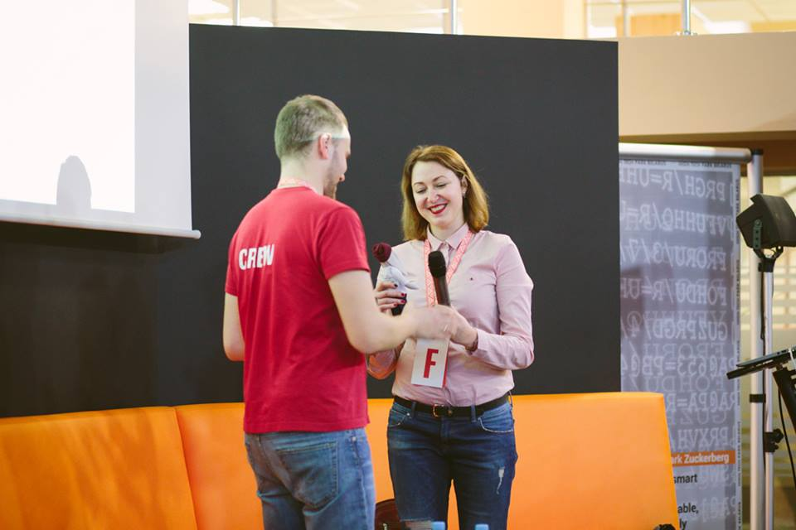
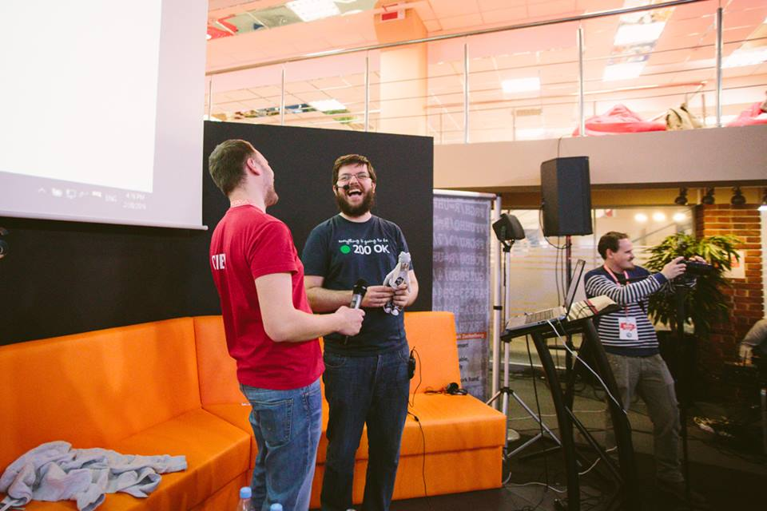
RSConf2016: Oscars for Speakers

Slide 10
RSConf2016: Participants
Participants
400+
Belarus
Russia
Ukraine
Poland
Lithuania

Slide 11
Supported by
EPAM
Yandex
Wargaming
Google
Mozilla
GitHub
JetBrains
…
Join! rolling.scopes@gmail.com

Slide 12
CALL FOR SPEAKERS!
rolling.scopes@gmail.com

Slide 13
Let’s Roll!!!
rolling.scopes@gmail.com

